Slide 1
Computer Networks
Course Code CPS-422
SPLICING OPTICAL FIBER CABLE
Lab 04
Demonstrator Kabeer Ahmed
MS Telecommunication and Networks from Iqra University

Slide 2
Fusion Splicing
Fusion splicing is the act of joining two optical fibers end-to-end using heat. There are several reasons for splicing a fiber cable, these include:
To join two fibers due to a breakage.
To connect some of the cores straight through a patch cabinet.
To extend a cable run.
To reduce losses, a fusion splice has much lower losses than two connectorized cables joined through a coupler.
Or to attach a pre-terminated pigtail.

Slide 3
SAFETY
When working with fiber there are a few rules that MUST always be remembered and practiced

Slide 4
Safety Glasses
Safety glasses MUST be worn at all times during the fiber optic lab exercises or anytime termination or splicing work is performed on a fiber cable. The biggest hazard when working with fiber optics are small, sharp shards of the fiber produced when stripping or cleaving the cable!!!
If you notice at any time a classmate or instructor not wearing safety glasses in the area where fiber is being cut, stripped, or cleaved, you must immediately tell the person to put on their glasses and tell the instructor.

Slide 5
Glass Fiber Shards
Be very careful when disposing of fiber ends. Use a Disposable Fiber Trash Bin (Fiber Disposal Unit =FDU) to hold small bits of glass until they can properly disposed of in the trash. For safety, remember to cover the holes on top of the FDU before storing your bin (unit) in your tool kits (box).

Slide 6
If you don’t have a FDU to use when working in some environments, then carefully make a container, like a half empty water bottle or soda can, before using. This helps to prevent accidents.
Make time to mark the container in some meaningful way with markers or tape. This will prevent someone from accidentally drinking fiber shards.

Slide 7
The glass fiber creates slivers or shards that can easily cause injury to the eyes or create glass splinters in fingers or hands that are difficult to see to remove from skin, which can become infected if not completely removed. Always keep a disposable fiber trash bin nearby for all fiber scraps. Develop the habit of picking up scraps from the work surface and the floor too. You may know a glass shard is dropped or lost and can take care, but another person like a co-worker or cleaning crew may come along and not be aware that fiber was being worked in the area.
Scotch tape can be used to pick up small shards of fiber. Fold the scotch tape around the glass shards before disposing in the trash can. This helps to keep others, like members of the cleaning crew, from becoming hurt accidentally.

Slide 8
Black Paper
Black paper or other dark colored paper or fabric can be used to give a dark colored work surface. This helps make the fiber more visible when working with it. It has the side benefit of allowing the fiber cores to be more easily seen, especially when you have a run away shard.

Slide 9
Chemicals
When doing fiber work epoxy, anaerobic adhesive (?), and isopropyl alcohol will be used. The isopropyl alcohol is flammable. (Anything else flammable as well?) Take extra care when handling these substances. It is best to develop the habit of watching for bits of epoxy on your tools or work surface and cleaning it with the alcohol. Develop the habit of wiping all tools frequently with a fiber free cloth or wipe and alcohol.
Keep in mind that epoxy is not removable from clothing!

Slide 10
Skin Oils
Do not touch bare fibers with fingers. The oil from your skin can weaken the fiber over time. It tends to make the glass fiber brittle

Slide 11
Hot ovens & terminators
Terminators removed from the curing ovens will be EXTREMELY HOT! Use caution when touching hot terminators. Small amounts of alcohol on a fiber free wipe may be used to help cool the terminator more quickly.
After the terminator is removed from the oven, the exposed fiber is dangerous and more brittle. Take great care to ensure the glass rod does not break, pierce the skin, or get into the eyes of you or any other person.

Slide 12
General Precautions
How to handle optical fiber.
When the fiber is not handled properly – stress as torsion, bend, tension etc.
Lorry with air cond. If dust is presence in the splicing – loss will increase.
Cutting OFC – do not use a metallic saw, use a cable cutter.
Keep your hand clean.

Slide 13
TOOLS AND EQUIPMENT
NO | TOOLS NAME | USE
1 | Bolt cutter | Cutting of the cable
2 | Scissors | Cutting paper
3 | Lap cutter | Removal of cable sheath
4 | Phillip screw driver set. | Tightning the screw
5 | Marking scale | For positioning cable clamp
6 | Tape measuring | Measurement
7 | Spanner set | Tightning nuts
8 | Hammer | Common used
9 | Knife | Removal plastic
10 | Torque wrench | For fixing the modal A cable replace
11 | Pliers combination | For cutting tension members
12 | Cleaver | Cutting optical fiber core
13 | Core stripper | Stripping secondary coating

Slide 14
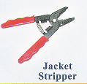
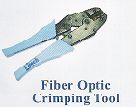
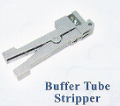
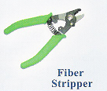
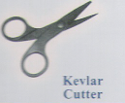
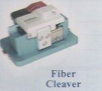

Slide 15
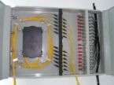
Materials used for cable splicing
  Fiber Optic Cable
  Closure
  Termination box, panel, FDF.
  Pig tail
  Protection sleeve
  Alcohol
  Cotton gauze
  Cotton Bud
  Cotton waste.

Slide 16
Method of cable Splicing
Determination of splicingposition
Stripping-off the cable sheath
Connection of the tension member
Preparation of mechanical closure
Splicing of the Optical fiber cable.
Splicing loss measurement.- be taken every time.
Protective treatment for the surplus of optical fiber cable
Cable sheath jointing
Closing of cable splicing.

Slide 17
Basic Steps
There are four basic steps to fusion splicing
1 - Strip back all coatings down to the bare fibers
and clean using isopropyl alcohol.
2 - Cleave the fibers using a precision cleaving
tool and put the heat shrink tube on to one of
the ends.
3 - Fuse the fibers together in the fusion splicer.
4 - Put the heat shrink protector on the fiber
joint.

Slide 18
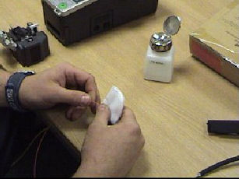
Stripping
Strip back the external sheathing of the cable using a rotary stripping tool. Cut back the aramid strength member using ceramic or kevlar scissors.
Strip the primary buffer from the fiber using fiber strippers
not ordinary wire strippers. Do this a small section at a time
to prevent the fiber breaking, about 10mm (3/8 in) on each
cut is fine until you get used to it. Strip back about 35mm
(1.5 in).
Clean the bare fiber with a lint free wipe and isopropyl alcohol, it will "squeak" when it is clean.

Slide 19
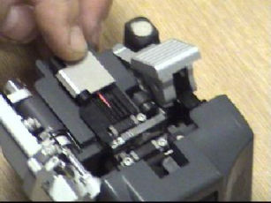
Cleaving
The cleaver first scores the fiber and then pulls the fiber apart to make a clean break. It is important that the ends are smooth and perpendicular to get a good joint, this is why a hand held cleaver will not do.
Basically the operation consists of putting the fiber into the groove and clamping, then close the lid and press the lever

Slide 20
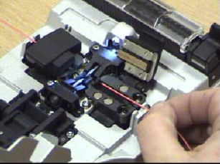
The Fusion Process
Once the fiber ends are prepared they are placed in the fusion splicer. Press the button and the machine takes care of the rest of the fusion process automatically
First the two fibers are aligned, you can see this on the photo where a much magnified image shows the two fiber ends. The display also shows how well the cleaver does its job of producing a perfect 90 degree cut.

Slide 21
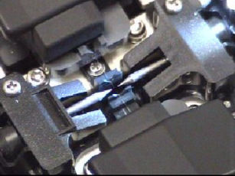
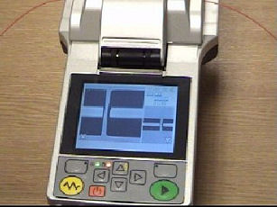
Once the fibers are aligned the splicer fires an electric arc between the two ends which melts them immediately and pushes them together, or fuses them into one piece of fiber.
The fusion splicer then tests for dB loss and tensile strength before giving the "OK" beeps for you to remove the splice from the machine.

Slide 22
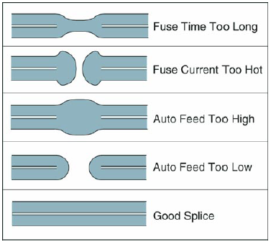
Screen Displayed

Slide 23
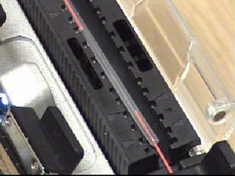
Protection
The protective tube gives physical protection to the splice and further protection is provided by placing the splice into a splice tray.

Slide 24
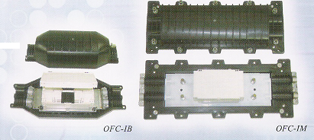
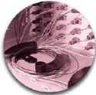
Once all of the fibers have been joined the whole tray is then fixed into a splice box which protects the cable joint as a whole and the cable clamps are then tightened to prevent any external forces from pulling on the splices.

